Slide 1

Team : 06
Food brand understand customer trend
GUIDANCE BY : PAVITHRA KANNAN MAM

Slide 2




Team Members
JAGRUTI DESALE
SANSKAR CHOUDHARI
ADITYA SINGH

Slide 3

Project Introduction
Food delivery platforms like Swiggy and Zomato generate huge volumes of customer feedback in the form of ratings, reviews, and order data. This feedback contains valuable insights about customer preferences, satisfaction levels, and product performance. However, businesses often fail to leverage this raw data effectively due to its unstructured nature.
Our project aims to analyze customer feedback using Power BI to transform ratings into meaningful insights. We classified customer feedback into Positive, Average, and Negative sentiments, enabling a deeper understanding of customer experiences.

Slide 4
Project Overview
Focus on analyzing customer behavior toward food brands using collected data.
Utilized Power BI for visualization and analysis.
Identified seasonal trends, demand patterns, and brand performance.
outcome
Understanding customer preferences for better business decisions.

Slide 5
Key Features
Collection & preprocessing of sales and customer feedback data.
Sentiment analysis (Excellent>4.5, Good>4, Average>3.5, Poor).
Price categories (Low: <300, Medium: 300-600, High: >600, premium: >1000)
Delivery Speed (Fast: <45 Min, Medium: 46-60 Min, Slow: >60 Min)
Interactive Power BI dashboards with charts, filters, and drill-downs.
Price-wise and product-wise comparison.
Region-based and demographic insights.

Slide 6


Milestones
Team : 06
Customer Satisfaction & Delivery Performance Analysis
Q3 2025 Insights & Recommendations
Team Members
JAGRUTI DESALE
SANSKAR CHOUDHARI
ADITYA SINGH

Slide 7

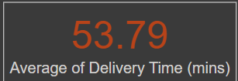
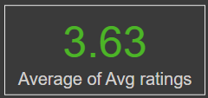
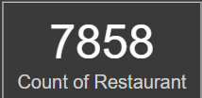
Executive Summary & KPIs
Executive Summary : A National Overview
Objective : Identify key drivers of customer satisfaction & operational improvements.
This analysis was conducted to identify the key drivers of customer satisfaction and uncover opportunities for operational improvement.
At a national level, we're operating with an average customer rating of 3.63% , a network of over 7,858 restaurants, and a delivery time of 53.8 minutes.
The Core Finding : Performance varies widely by cuisine type and city, requiring localized strategies.
National KPIs :
Avg. rating : 3.63
Restaurants : 7,858
Avg. delivery time : 53.8 mins

Slide 8

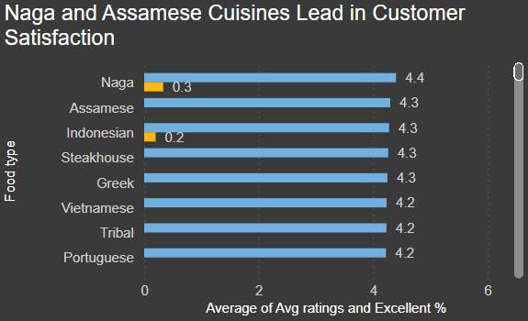
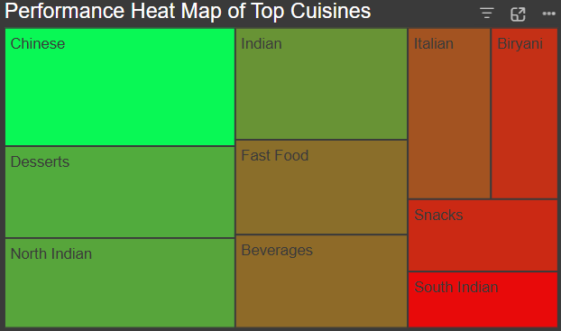
The Satisfaction - Popularity Gap
Our Most Popular Cuisines Are Not Our Highest-Rated
Key Insights : Identify key drivers of customer satisfaction & operational improvements.
The data reveals a critical disconnect: niche cuisines like Naga and Assamese receive the highest satisfaction scores from customers.
Chinese & Indian: dominate business volume but trail in satisfaction.
Opportunity : This gap represents our single largest opportunity. A focused effort to improve the quality of our highest-volume cuisines could significantly lift the overall company average rating.

Slide 9
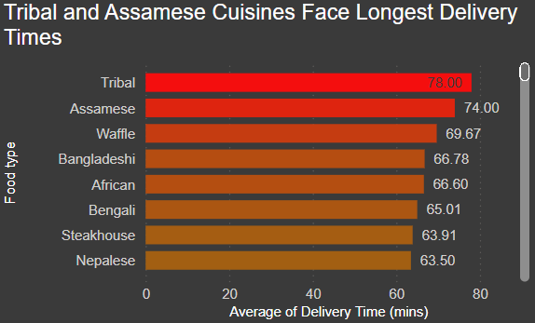
Delivery Bottleneck
Delivery Speed as an Operational Bottleneck
Key Insights :
Operationally, delivery time is a major factor in customer satisfaction. Our analysis shows that specific cuisines, like Tribal and Waffles, consistently face the longest delivery times.
Tribal : 78 mins average delivery.
Assamese : 74 mins.
Waffles, Bangladeshi, African also high delays
Risk : Poor customer experience, reputation damage, retention issues

Slide 10
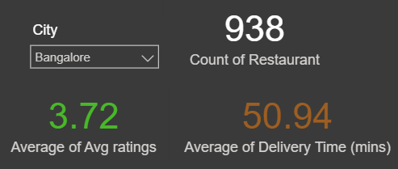
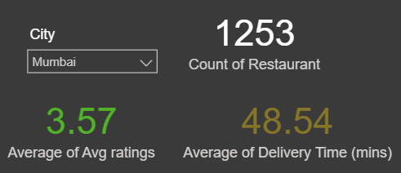
Hyper-Local Performance
A Tale of Two Cities – Bangalore vs. Mumbai
Key Insights :
The national average hides crucial local differences. In Bangalore, the average rating is a strong 3.72, but in Mumbai, it drops to 3.57.
Bangalore : Avg. rating 3.72 (above national average).
Mumbai: Avg. rating 3.57 (below national average).
Different Tastes & Problems: Highlight that the top-rated cuisines and the cuisines with the worst delivery times are completely different in each city.
Strategic Implication : One-size-fits-all approach fails; empower local managers with city-level insights.

Slide 11

Strategic Recommendations
Recommendations & Next Steps
Actionable Recommendations :
Launch a Quality Pilot Program : Based on the satisfaction-popularity gap, I recommend we launch a pilot program with our top 20% highest-volume Chinese and Indian partners to co-develop higher-quality menu options.
Conduct a Logistical Review : To address the delivery bottleneck, I recommend a logistical review of the three cuisines with the longest delivery times to identify and resolve root causes.
Empower Regional Managers : Roll out this interactive dashboard, starting with the Bangalore and Mumbai city managers, to enable data-driven decision-making at the local level.

Slide 12

Thank you
Team : 06
We appreciate the opportunity to present our project on Customer Sentiment & Food Trend Analysis. Your feedback and suggestions will help us improve and take this work further.
Thank you for your time and attention!

